Slide 1


AZURE VIRTUAL DESKTOP

Slide 2
AGENDA
AVD Overview
Features
Host Pool Overview
Personal
Pooled
FSLogix
User Profiles
Licensing

Slide 3

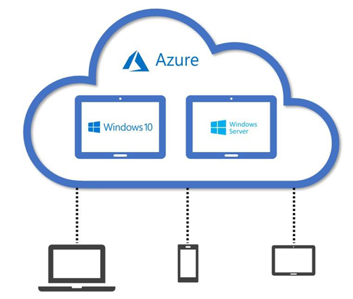

AZURE VIRTUAL DESKTOP IS A DESKTOP AND Application VIRTUALIZATION SERVICE THAT RUNS ON THE MICROSOFT AZURE. AZURE VIRTUAL DESKTOP CAN BE ACCESSED FROM ANY DEVICE SUCH AS WINDOWS, MAC, IOS, ANDROID, AND LINUX.
OVERVIEW

Slide 4


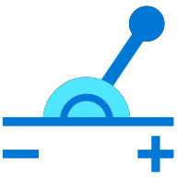

FEATURES
Empowering remote work
An increasing number of companies are implementing VDI for remote workers because virtual desktops are easier to deploy and update from a centralized location.
Bring Your Own Device
VDI is an ideal solution for organizations with BYOD policies. It also helps with data security because data lives on the server and is kept off the client devices.
Deploy and scale in minutes
Simplify deployment and management of your infrastructure and scale quickly based on your business needs.
Reduce cost using existing licenses
Use existing eligible licenses to reduce costs with a modern cloud-based virtual desktop infrastructure (VDI) and pay only for what you use.
4

Slide 5
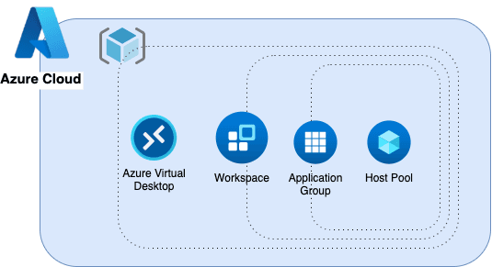
HOST POOLS
A host pool is a collection of Azure virtual machines that register to Azure Virtual Desktop as session hosts when you run the Azure Virtual Desktop agent.
All session host virtual machines in a host pool should be sourced from the same image for a consistent user experience. You control the resources published to users through application groups.
List of Host Pools;
POOLED
PERSONAL

Slide 6
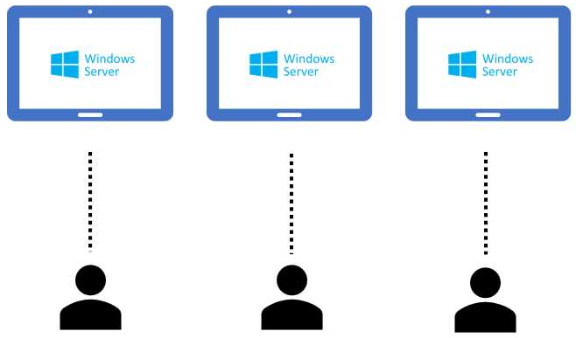
Personal
Personal where each session host is assigned to an individual user. Personal host pools provide dedicated desktops to end-users that optimize environments for performance and data separation.
User assignment process - Users can either be directly assigned to session hosts or be automatically assigned to the first available session host. Users always have sessions on the session hosts they are assigned to.
User data - Each user only ever uses one session host, so they can store their user profile data on the operating system (OS) disk of the VM.

Slide 7
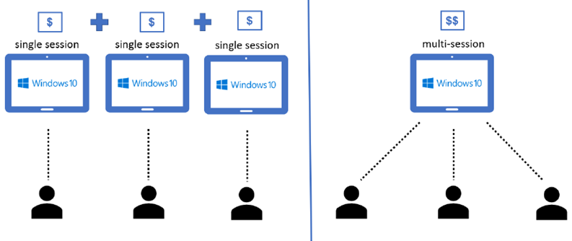
POOLED
Pooled where user sessions can be load balanced to any session host in the host pool. There can be multiple different users on a single session host at the same time. Pooled host pools provide a shared remote experience to end-users, which ensures lower costs and greater efficiency.
User assignment process - Users aren't assigned to session hosts. After a user signs out and signs back in, their user session might get load balanced to a different session host.
User data - Users can connect to different session hosts every time they connect, so they should store their user profile data in FSLogix.

Slide 8
FSLOGIX
The Azure Virtual Desktop service recommends FSLogix profile containers as a user profile solution. FSLogix is designed to roam profiles in remote computing environments, such as Azure Virtual Desktop.
FSLogix stores a complete user profile in a single container. At sign in, this container is dynamically attached to the computing environment using natively supported Virtual Hard Disk (VHD) and Hyper-V Virtual Hard disk (VHDX).
Storage for maintaining profile are Azure File Storage, Azure NetApp, Storage Spaces.
OneDrive - Without FSLogix profile containers, OneDrive for Business is not supported in non-persistent RDSH or VDI environments.

Slide 9
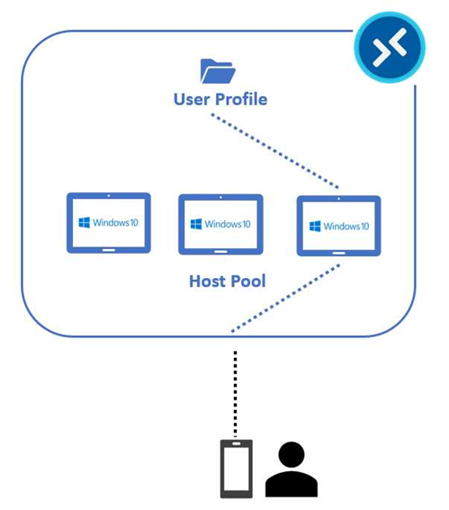
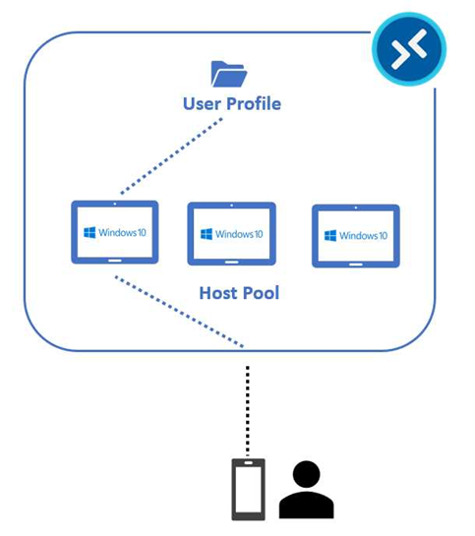
Let’s pretend that the first day of usage, the user is redirected to the first virtual machine of our pool. So, the VHD/VHDX file that contains their user profile is attached to virtual machine 1.
FSLogix User Profile Attach on Day 2
On the second day, the user requests the same service, but now the system is assigning the third virtual machine of the pool, so the VHD/VHDX file is now mounted into the virtual machine 3 file system.
FSLogix User Profile Attach on Day 1

Slide 10
User profiles
A user profile contains data elements about an individual, including configuration information like desktop settings, persistent network connections, and application settings.
A remote user profile provides a partition between user data and the operating system. It allows the operating system to be replaced or changed without affecting the user data.
The FSLogix installed inside each virtual machine, the user profile is maintained in a share inside Azure (for example in an Azure Files file share), and it’s attached at the time of login.

Slide 11

LICENSING
Operating System | License Entitlement
Windows 10 Enterprise | Microsoft 365 - Business Premium, E3, E5, F3, A3, A5.
Windows 10 Enterprise multi session
Windows 11 Enterprise | Windows Enterprise E3, E5 and Education A3, A5.
Windows 11 Enterprise multi session
Operating System | License Entitlement
Windows Server 2022 | Remote Desktop Services (RDS) Client Access License (CAL) with Software Assurance (per-user or per-device), or RDS User Subscription Licenses.
Windows Server 2019
Windows Server 2016
Windows Server 2012 R2

Slide 12
THANKYOU

